Slide 1
Welcome to Ash Class!
Teacher: Miss Mahmood
Teaching Assistant: Mrs Turner

Slide 2
Expectations
In Ash class children are expected to always show the school values; honesty, collaboration, respect and kindness. As well as have fun and enjoy themselves!
Please make sure to listen to your child read each night from either:
Book band,
Library,
Guided reading book.
Spelling homework will be sent out weekly on a Wednesday via your child’s STARZ+ account. Children will be tested the following Friday! This should also support correct letter formation
Maths homework will be sent home termly. Children are encouraged to complete each task weekly.
Please can I have a note to say where your child is going or who is collecting each evening!
Notes:
Reading each night – This might be a couple of pages, to a whole book. If children are really tired after school, read in the morning.
What makes their reading better is having good phonic knowledge skills and a sight vocabulary. Practice is the only way they improve their reading. When reading with your children ask questions about the book. What is happening? what might happen next? (see handout)
Bring the reading record and book back everyday even if you haven’t read that evening. There might be a chance to read in school.
Spelling test once a week. These will come through on starz+. Given on a Wednesday to be tested following Friday!
Homework on Sumdog, this will be assigned on a Wednesday and timed to close on 9am Monday and it will reflect what is being taught in school.
(If you think you will have an issue accessing the internet or computers or if there is any issue regarding this please come and see me asap)

Slide 3
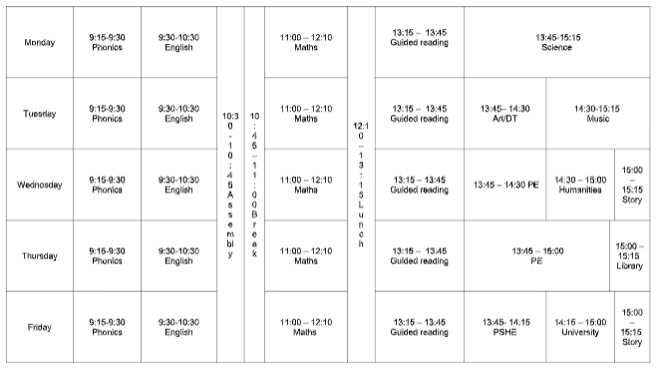
Notes:
This is our weekly timetable.
PE is on a Monday and a Wednesday, Forest fun is on a Thursday afternoon every other week.

Slide 4
Projects
Autumn 1 – Looking back at Britain.
The Ice Age, The Bronze Age, The Iron Age
Notes:
Up! – We will be learning about the progression of flight, learning about the wright brothers and the progression of the aeroplane in our lifetime.

Slide 5
Academic Expectations.
Year 1: Phonics screening in June
1:1 assessment with class teacher
Notes:
1:1 assessment with class teacher. – if they fail it they retake
2 reading 2 maths yet to hear about spag first half of summer term (After easter) NO holidays, appointments.

Slide 6
PE
PE will be on Wednesday and Thursday.
Please can each child have the following in school at all times:
Black shorts
White top,
Socks
Jogging bottoms
Jumper
Trainers
It is important children have the correct PE uniform for each session.
Earrings and jewellery are not allowed to be worn during PE lessons.
Notes:
This is important to have in school at all times because there could be something happening in school and our PE times could vary. Trainers are important. We will not be allowing children to participate in PE if they haven’t got correct shoes.
If you have any queries or are worried about anything regarding PE please don’t hesitate to come and talk to me.

