Slide 1
Year 4 – Penguins
Meet the Teacher
Mrs McKay

Slide 2
Ethos/Expectations
Work hard, learn lots, have fun
Positive classroom climate – foster ‘risk taking’
Independent learners
Secure foundations – e.g. times tables, handwriting, reading, spelling
Talk for learning and quiet independent work
All children to have the opportunity to work in a group with an adult

Slide 3
Weekly Timetable
 | 9:10 | 9:30 | 10:30 Assembly | 11:00 |  | 12:00 | 1:45 | 2:35
Monday | Review Guided Reading and homework | Maths |  | English |  | Guided Reading | PSHE/ Class Council | ICT
Tuesday | Spelling | Maths |  | English |  | Guided Reading | RE | PE
Wednesday | Homework/ Handwriting | Maths |  | English |  | Guided Reading | Topic | Art
Thursday | Spelling | Maths |  | English |  | Guided Reading | PE | Music/DT
Friday | Spelling | Science |  | Library | French | Guided Reading | University

Slide 4
English
Focus on composition and effect – the purpose and the reader
Texts that interest and engage the children (and me)
Ensure the rules of grammar are known and applied
Narrative and Non Fiction each term
Reading – impact on writing

Slide 5
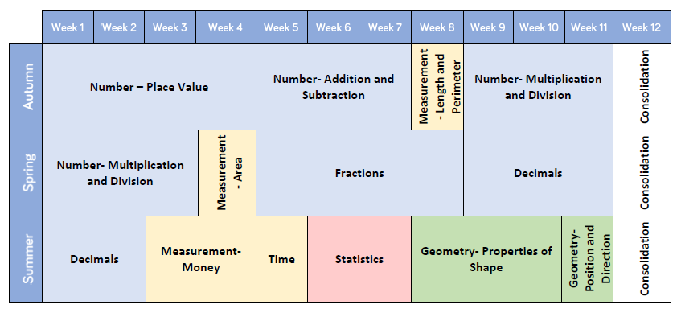
Maths Curriculum

Slide 6
Maths
Focus on both fluency and application
Physical apparatus, models/diagrams, images - different ways of presenting information
A journey and the communication of ideas not just ticking the ‘right answer’
Times tables

Slide 7
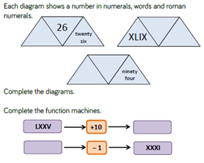
Fluency Example

Slide 8
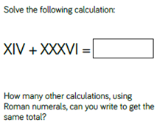
Problem Solving Example

Slide 9
Homework
Out Wednesday, back Monday
Maths
Reading
  at least 3 times/week recorded in reading record
  with an adult
  a wide range of good quality texts
Spelling
  practise 5 words per week from Y3/4 word list
  please check they are accurate

Slide 10
PE
Foster a life-long love of being active
Tuesday and Thursday
PE kit in school all week please

Slide 11
Other Subjects
Autumn
  History/Geography The Romans and Coasts/Water Cycle
  Science – sound and states of matter
  Art – study of contemporary artist
  RE – commitment and belonging and different places of Christian worship
  PSHE – Citizenship, Myself and My Relationships, Anti Bullying
  ICT – E Safety and Word Processing
  PE – Football, Hockey, Cross Country, Dodgeball and Gymnastics
  Music – Mamma Mia
  French – Numbers to 69 and siblings
  DT – Juggling Balls

Slide 12
Other Subjects
Spring
  History/Geography – Local Study and Anglo Saxons/Scots
  Science – Electricity
  Art – Fen Focus
  RE – Good and Evil and Is Easter the festival of new life or sacrifice?
  PSHE – Economic Well Being, Financial Capability, Drug Education
  ICT – Animation and Programming
  PE – Tag Rugby, Gymnastics, Netball, Dance
  Music – Stop or Lean on Me
  French – Pets, Family, Ice-Cream
  DT – Mechanical Posters

Slide 13
Other Subjects
Summer
  History/Geography – All Around the World and Crime and Punishment
  Science – Animals including Humans and Living Things and Their Habitats
  Art – William Morris
  RE – Sikhs in Britain and Peace
  PSHE – Personal Safety, RSE, Myself and My Relationships 2, Managing Changes
  ICT – Photo Stories
  PE – Tennis, Swimming, Kwik Cricket, Athletics
  Music – Blackbird
  French – Personality, Adjectives, Music, Little Red Riding Hood
  DT – Let’s Go Fly a Kite

Slide 14
Further Questions?

