Slide 1
Year 3 Presentation
Meet the teacher

Slide 2
Year 3 Class Profile and staffing
Currently there are 20 pupils in our class: 13 boys and 7 girls.
Miss Hime teaches Monday, Tuesday, Wednesday, Thursday morning and Friday.
Mrs Flinders teaches on Thursday afternoons when Miss Hime is on PPA.
Mrs Eldridge supports the class in the mornings.
Our class name is Horse Chestnut.

Slide 3
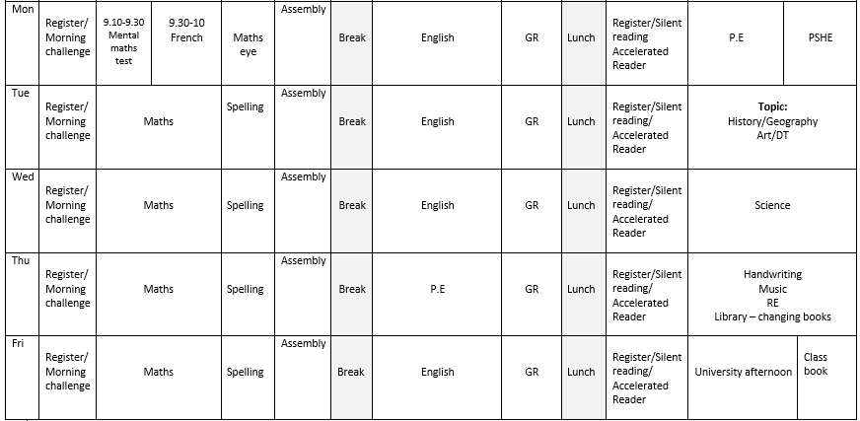

Slide 4
Age related expectations
Please look at age related expectations for English, Maths and Science which are core subjects.
These are split into Emerging, Developing, Secure, Greater Depth.
Foundation subjects are: Art, Physical Education, Music, Religious Education, Modern Foreign Language, Design and Technology, Personal Social and Health and Citizenship Education, History and Geography.
We adjust the curriculum to achieve balance with foundation subjects across the year.

Slide 5
What will we be learning this half term?
Please refer to your weekly newsletter.

Slide 6
Homework
Homework sent home on Wednesday and should be returned on Monday.
Usually homework will be spellings with spelling activities and maths problem solving activities.
We also subscribe to Times table rock stars.
Spellings are reviewed in dictation activities in class on Mondays.
If you are unable to complete homework please just write a note in the book.
Make a regular time to do homework in a quiet place.
If you have any difficulties, just make a note in the homework book.
Children should read to an adult at least three times a week as part of their homework.

Slide 7
Reading
Reading is part of homework and pupils should read with an adult at least three times a week. Please record this in their reading record.
At school we do not have the capacity to read individually with everybody during the week so your role is really important.
We do complete guided reading sessions in groups to teach reading skills and develop inference and comprehension.
Questioning is a really important part of reading to check understanding.
It is the children’s responsibility to ask to change their book.
We monitor book’s weekly to check that children are being read with at home so please sign the reading record.

Slide 8
Weekly Routines
PE –Monday and Thursday. Correct kit please and no jewellery.
Homework out on Wednesday back to school on Monday.
Tuck shop: Tuesdays and Fridays (20p).
Pupil Premium children are entitled to complementary tuck shop items and milk.
Children do not receive fruit in Key stage 2 so please provide a snack if you wish.
Water bottle daily.
No pencil cases needed.
Any money please label clearly and place in a sealed envelope.

Slide 9
Keeping in touch
Any administration queries please contact the office directly.
Please contact me via the office.
If I need to contact you, I will email or phone.
Please ensure contact details are up to date.
Parent consultations will continue to be at the end of October and in March. In the summer, we have our Open Evening.
Information is issued on Parent mail from the office.
Keep up to date with Mrs Worth’s weekly newsletter published on Fridays.

Slide 10
Safeguarding
Please let the school know about any medical issues your child may have e.g. asthma, allergies etc.
If there is any change to your routine for who is collecting your child (or if your child is going on the bus or to Fun times), please let us know in writing or by contacting the office.
If you visit school, please sign in at the office and one of the staff will escort you through the building.
After three weeks children will come out on their own.

Slide 11
How can I help my child?
Breakfast
A good bedtime routine
Encourage children to be independent in little ways.
Help children to be organized so they get themselves ready and take responsibility.
Read regularly.
Create a homework routine.
Use everyday experiences as learning opportunities.
Make time every day to speak to your child without any digital devices.
Keep in touch with school.

