Slide 1
Parent teacher meeting 11.09.19

Slide 2
Monday | Maths Problem/ Grammar | English |  | French |  |  | Maths (including Third Space Learning) | Guided Reading |  |  | ERIC | PE - Indoor | Knowledge Curriculum
Tuesday | Maths Problem/ Grammar |  | Maths | SPaG |  |  | English |  | Guided Reading |  | ERIC | Knowledge Curriculum
Wednesday | Homework |  | Maths |  | SPaG |  | English |  | Guided Reading |  | ERIC | Science
Thursday | Maths Problem/ Grammar |  | Maths (including Third Space Learning) | SPaG |  |  | English |  | Guided Reading |  | ERIC | PE - Outdoor | Knowledge Curriculum - Music | Library
Friday | Maths Problem/ Grammar |  | Maths | SPaG |  |  | English |  | Guided Reading |  | ERIC | University Afternoon |  | Class Reader

Slide 3
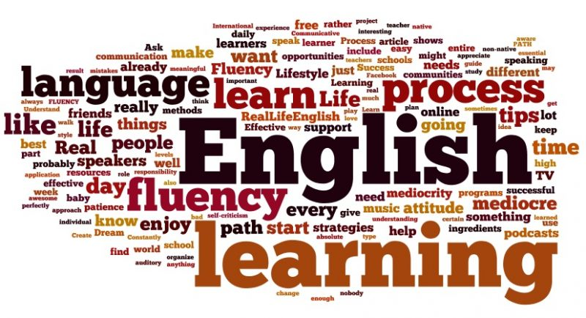
- Writing expectations ( see steps sheets for coverage of NC objectives)
By the end of year 6, children can plan independently, identifying the purpose and form of their writing using reading and research to support them. They are able to draft by: choosing the appropriate grammar & vocabulary to enhance meaning; using cohesive devices within and between paragraphs, using organisational features as a guide for the reader.
When evaluating their writing they can propose changes to clarify meaning and enhance the effect of the writing on the reader. Tenses, subject and verb agreement and the register for their writing are consistent and correct throughout. They automatically proofread for spelling and punctuation errors.

Slide 4
How do we teach it?
Cover a range of genre across the year
Work in units, through phases with ‘cold’ & ‘hot piece’
Chn encouraged to edit their work routinely.
This term - Starting with biographies – Charles Dickens, then narrative “Oliver Twist”
Spelling – discrete spelling sessions 4 x week
Spag – taught in context across the units, also discrete practice question sessions, so children are familiar with how the questions are phrased.

Slide 5
Reading expectations – see handout
By the end of year 6, children are fluent readers prepared for the demands of the year 7 curriculum. They discuss books with adults & peers confidently and can present their views formally. The children have read widely across a range of texts for different purposes and as a result are able to recommend books, giving reasons for their choices.
They have a wide repertoire of poems they have learnt by heart and can perform these, using the appropriate tone, volume & intonation.
They show a deep understanding of what they read because they are able to :automatically check reading makes sense; explore the meaning of words in context; ask & answer questions. They can draw inferences and predictions providing reasoned justifications for their views. They can summarise the main ideas within a text and identify details that support these themes.
They are ale to comment on the author’s use of language and the structure of the text. When reading non fiction they can easily retrieve, record and present what they find, distinguishing between fact and opinion.

Slide 6
Reading – what does this mean for parents?

Slide 7
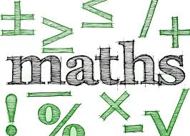
Maths – expectations
The principal focus of mathematics teaching in upper key stage 2 is to ensure that pupils extend their understanding of the number system and place value to include larger integers. This should develop the connections that pupils make between multiplication and division with fractions, decimals, percentages and ratio.
At this stage, pupils should develop their ability to solve a wider range of problems, including increasingly complex properties of numbers and arithmetic, and problems demanding efficient written and mental methods of calculation. With this foundation in arithmetic, pupils are introduced to the language of algebra as a means for solving a variety of problems. Teaching in geometry and measures should consolidate and extend knowledge developed in number. Teaching should also ensure that pupils classify shapes with increasingly complex geometric properties and that they learn the vocabulary they need to describe them.
By the end of year 6, pupils should be fluent in written methods for all 4 operations, including long multiplication and division, and in working with fractions, decimals and percentages.
Pupils should read, spell and pronounce mathematical vocabulary correctly.

Slide 8
How do we teach it?
Starting with number & place value and geometry
Entry & exit assessments
Work through a unit over a few weeks
Lots of work on vocabulary & maths & reasoning – children explaining their thinking
Chn must know their times tables – makes a huge difference.

Slide 9
How do we teach it?

Slide 11
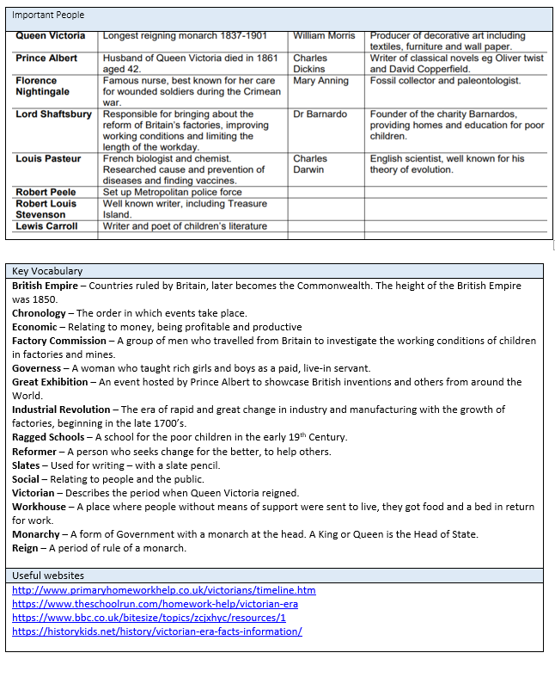

Slide 12
Homework / How you can help….
High frequency words – 5 &6 & dictation, linked to handwriting
Times Table Rockstars
Short practice questions – alternate between maths & reading – will be gone through in school.
Reading – daily reading – please keep up! Reading makes all the difference.
Friday – maths test on all areas – children will be bringing home a copy – it would be really helpful if you could go through any areas the children are unsure of – pick key ones.
Grammar exercises on SPaG.com

Slide 13
SATS info…
By then , the children will be familiar with the type of questions they will come across & will have had lots of practice at using & applying their skills & knowledge, so it should be nothing new / scary to them.
Children may be anxious, but we will talk to the children about this being a normal feeling, previous situations where they might have felt the same etc
We will also talk to them about having coping mechanisms, which will help reduce the anxiety ( see saw) Children need to experience anxiety, to learn & know they can cope with it.
SATS week is w.b. May 11th 2020 – after May Bank holiday
Sats meeting – tbc
Breakfast offered in morning to settle children down.

Slide 14
Questions????

